Slide 1

Client Server Computing
Name – Ayan Das
Roll - 311

Slide 2
Client Server Computing : Client–Server Computing is a computing model where tasks or workloads are divided between two types of machines one is called Client and another one is called Server.
Client: A client is any device or software that initiates communication by requesting data or services from a server. Common client applications include:
Web browsers (e.g., Chrome, Firefox)
Email apps (e.g., Gmail, Outlook)
Server: A server is a powerful systems that listens for and responds to client requests by delivering data or performing tasks. Servers often handle multiple simultaneous client requests. Common server applications include:
Web Servers (e.g., Apache, Nginx)
Email Servers
Database servers

Slide 3
Types of Clients:
Thin Client – Minimal processing power; depends mostly on the server (e.g., web browser).
Thick Client (Fat Client) – Has its own processing power and does part of the work locally (e.g., installed desktop applications like MS Word with online sync).
Types of Servers:
File Server – Stores and manages files.
Database Server – Provides database services and query handling.
Web Server – Hosts websites and web applications.
Application Server – Runs application logic and provides business services.
Mail Server – Handles sending and receiving emails.
Proxy Server – Acts as an intermediary for requests, often for security/caching.

Slide 4
Special Types of Clients and Servers
🔹 Special Types of Clients
Daytime Client – Connects to a server to get the current date and time.
Echo Client – Sends a message to the server and gets the exact same message back.
🔹 Special Types of Servers
Iterative Server – Handles one client at a time; after finishing, it moves to the next.
Concurrent Server – Can handle multiple clients at the same time, usually by creating new processes or threads.

Slide 5
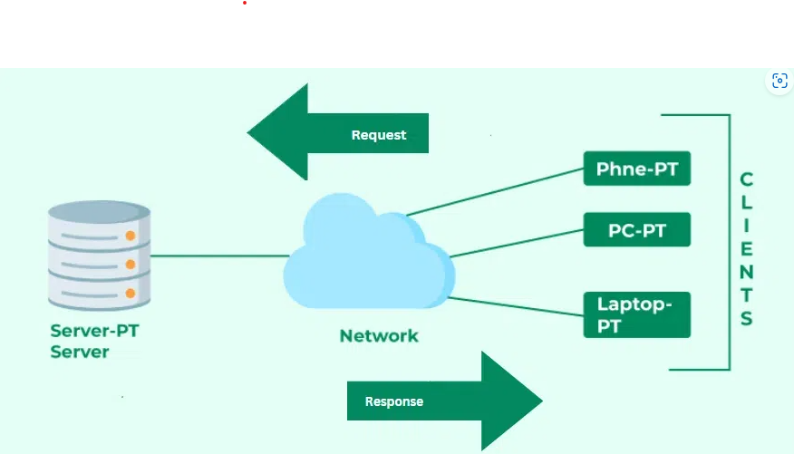
Client Server Model : The Client-Server Model is a distributed architecture where clients request services and servers provide them. It underpins many modern systems, including websites, email, and cloud storage platforms.

Slide 6
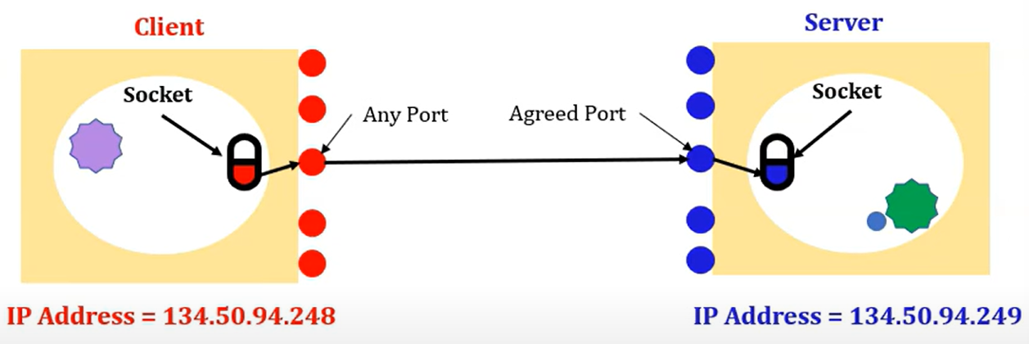
Socket
What is Socket ?
Socket is an end point of a two way communication between
programs running on a network.
How Socket works?

Slide 7
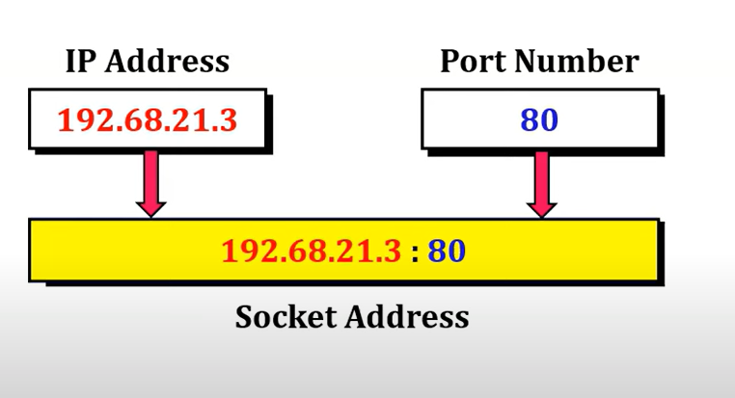
Socket Address

Slide 8
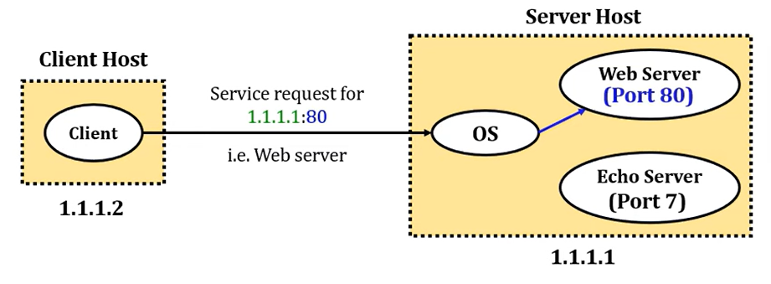
How to identify process using Socket?

Slide 9
Types of Socket
1.Stream Socket
2.Datagram Socket
Characteristic of Stream Socket
Reliable & Error free Service
Sequential Packet delivered
Characteristic of Datagram Socket
Unreliable & best effort service
Datagram may arrive out of order
Application of Stream Socket
Telnet/SSH,HTTP,HTTPS
Application of Datagram Socket
Live streaming audio/video

Slide 10
What is Socket Programming?
Socket programming is a way of connecting two nodes on a network to communicate with each other.
Which Functions are used for Socket Programming?
socket()
bind()
listen()
connect()
accept()
send()/recv()/read()/write()/sendto()/recvform()
close()

Slide 11
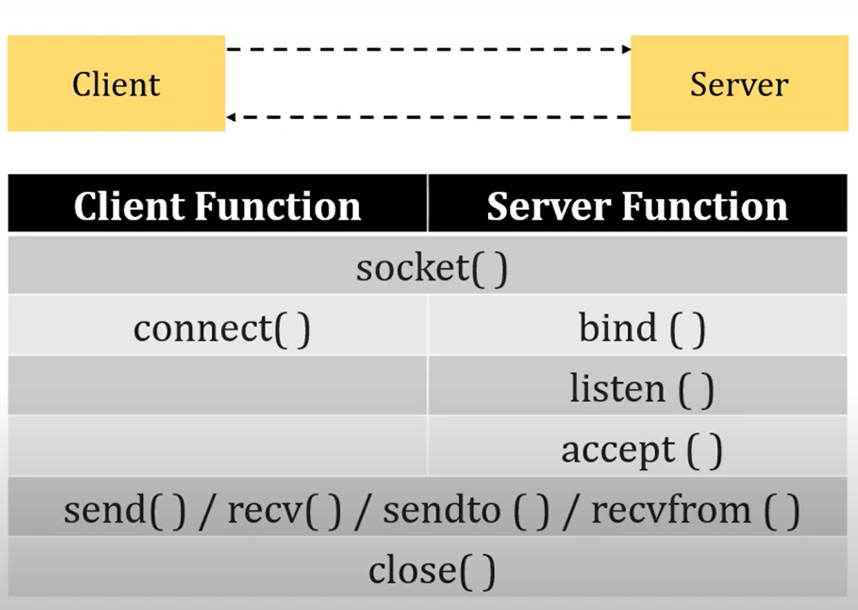

Slide 12
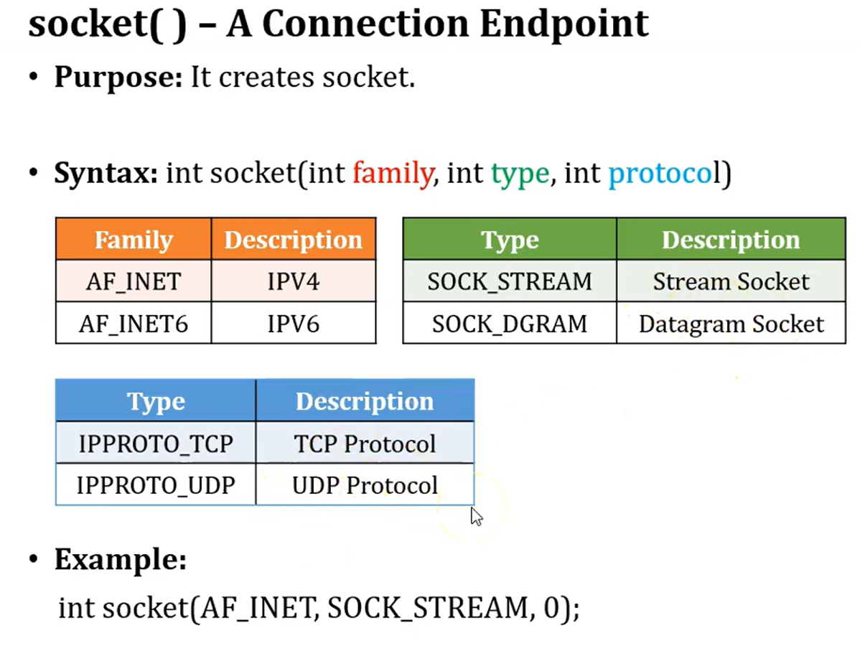


Slide 13
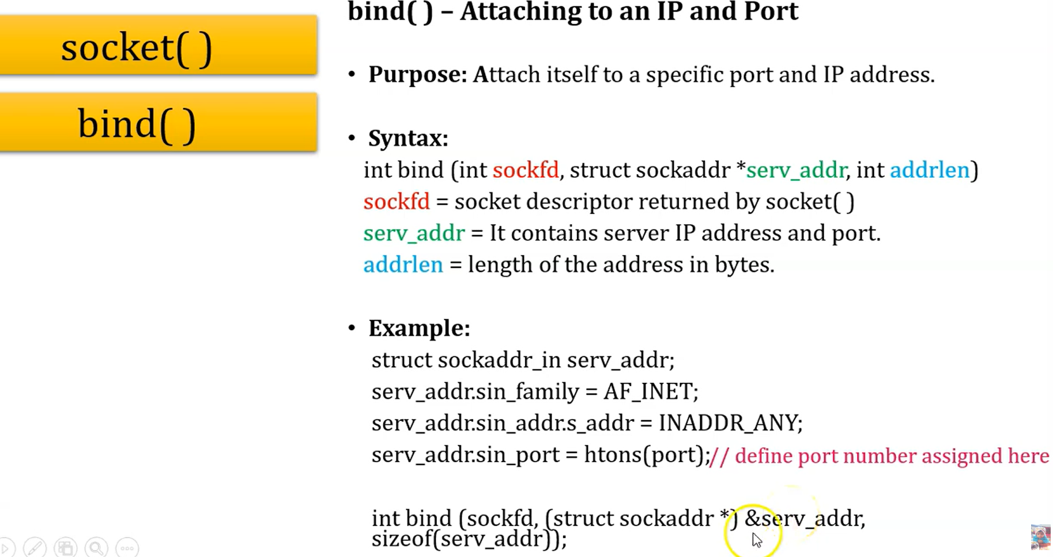
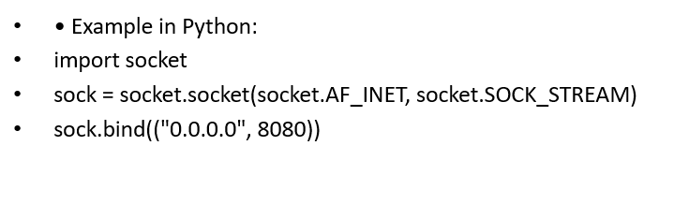

Slide 14
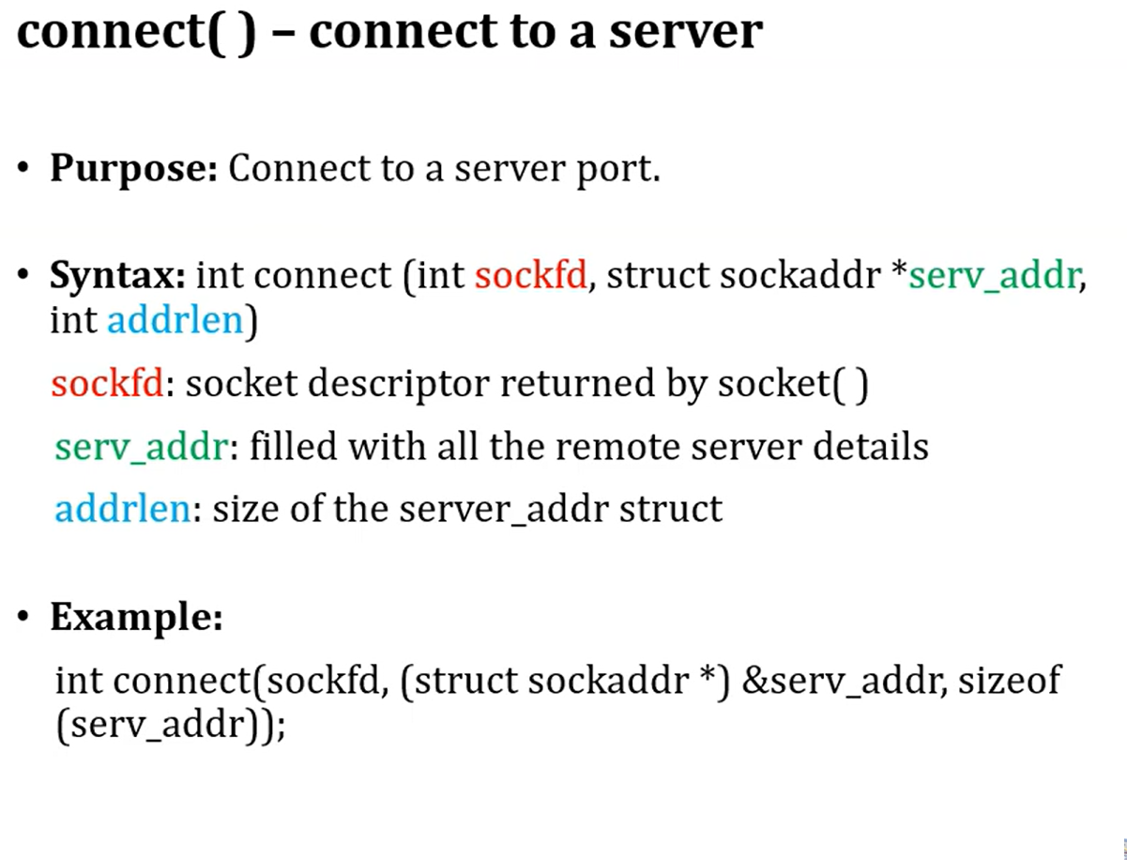
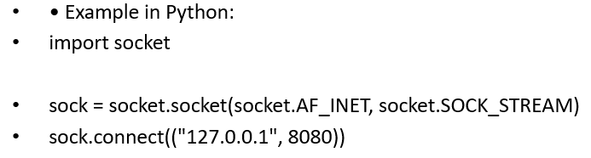

Slide 15
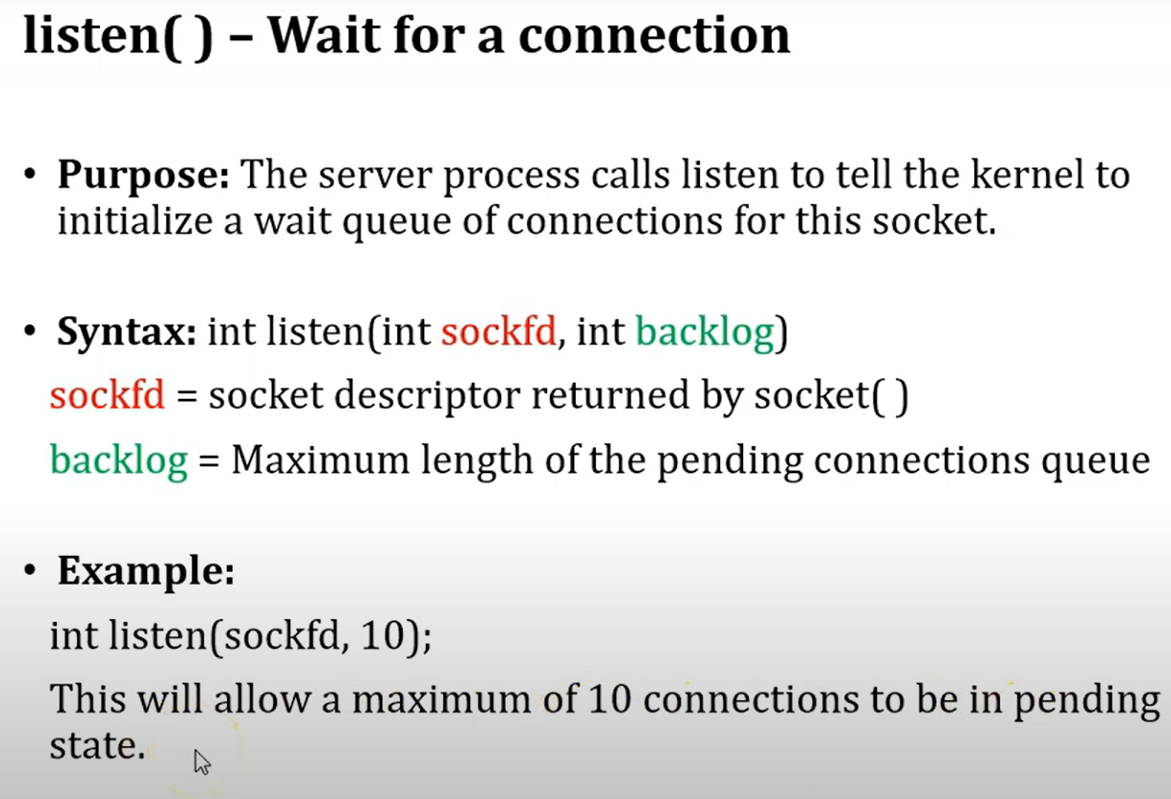
Example:
import socket
s = socket.socket(socket.AF_INET, socket.SOCK_STREAM)
s.bind(('localhost', 12345))
s.listen(10) # allow max 10 pending connections
print("Server is listening...")

Slide 16
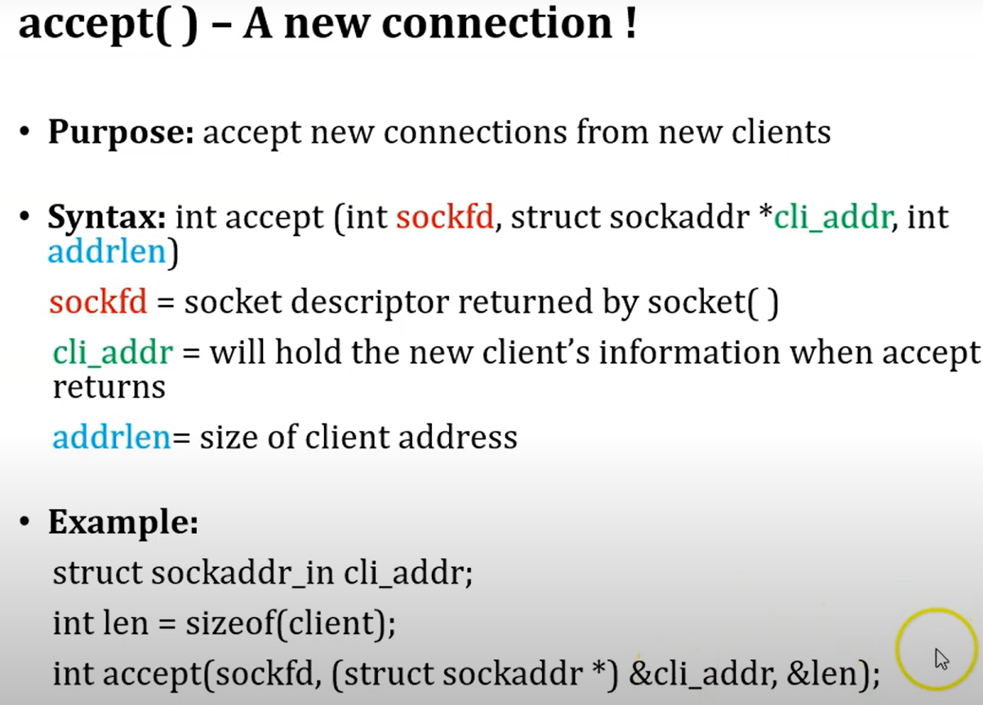





Example:
import socket
s = socket.socket(socket.AF_INET, socket.SOCK_STREAM)
s.bind(('localhost', 12345))
s.listen(5)
conn, addr = s.accept()
print("Connection from:", addr)

Slide 17
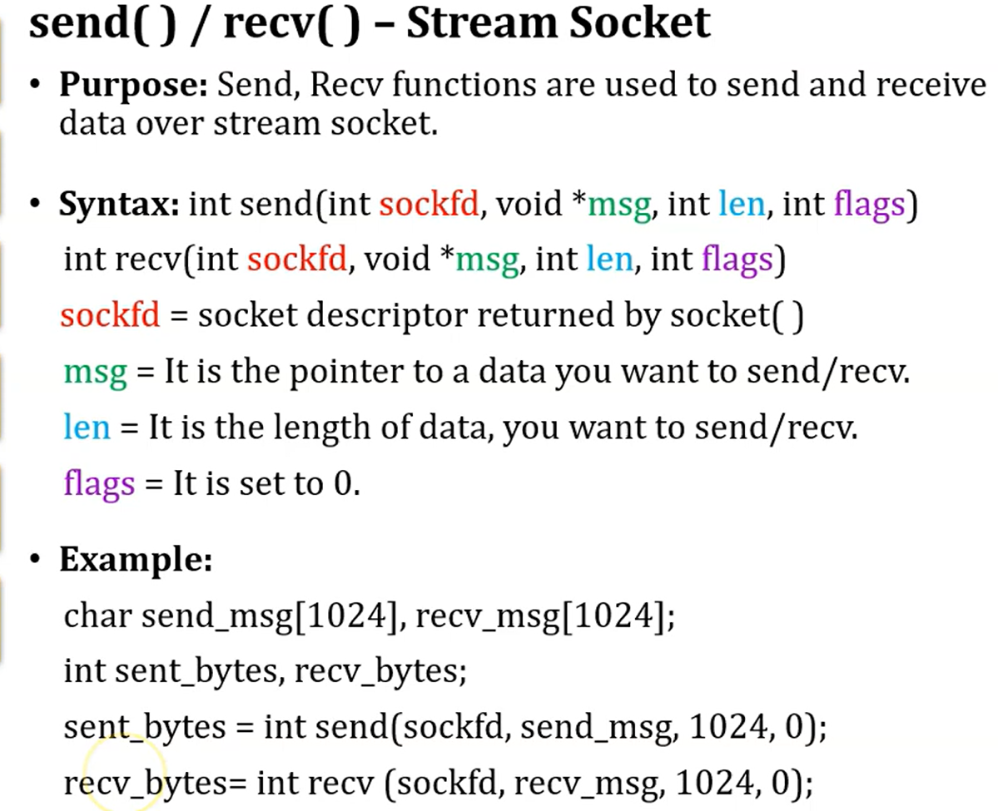
Example:
import socket
s = socket.socket(socket.AF_INET, socket.SOCK_STREAM)
s.connect(('localhost', 12345))
s.send(b"Hello, Server!") # send data
data = s.recv(1024) # receive up to 1024 bytes
print("Received from server:", data.decode())

Slide 18
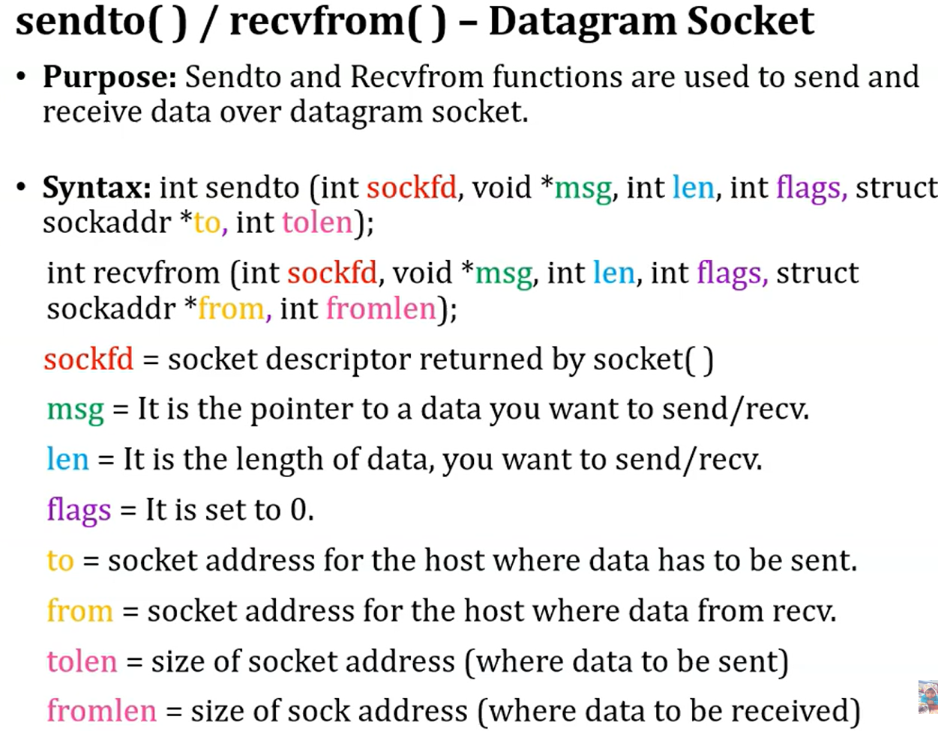

Slide 19
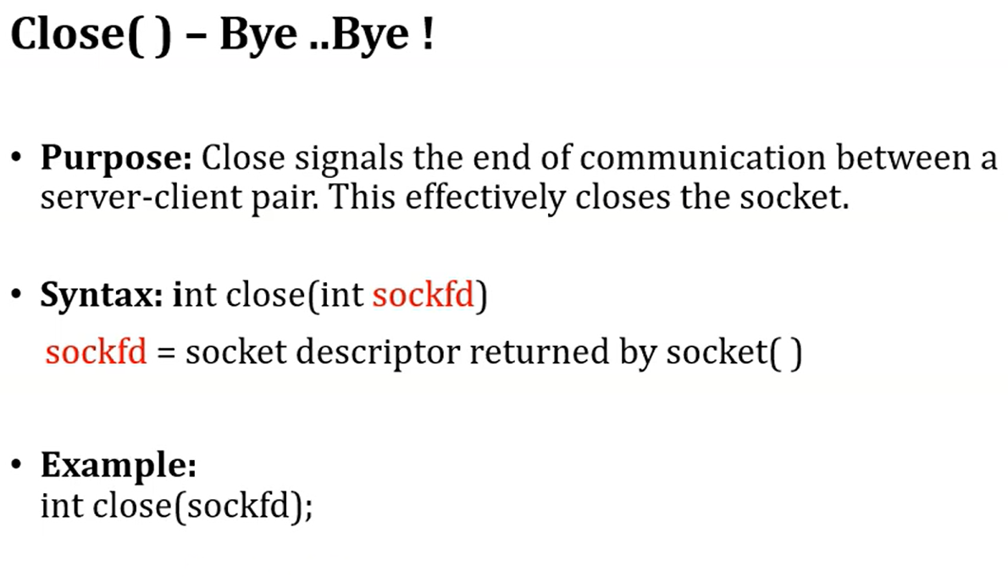
Example:
s.close()

Slide 20
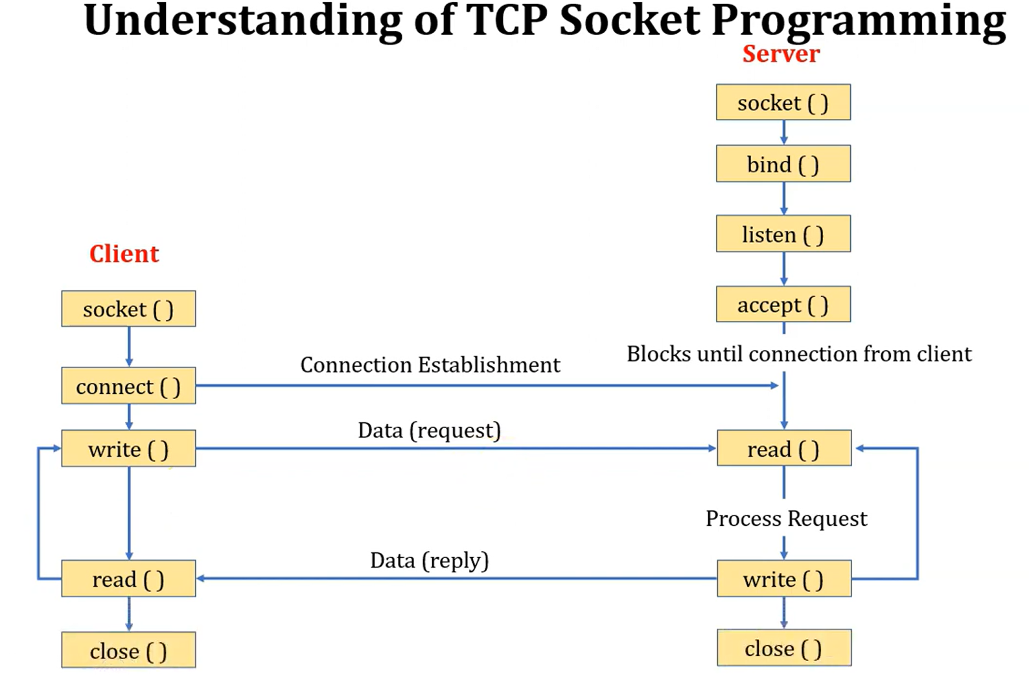

Slide 21
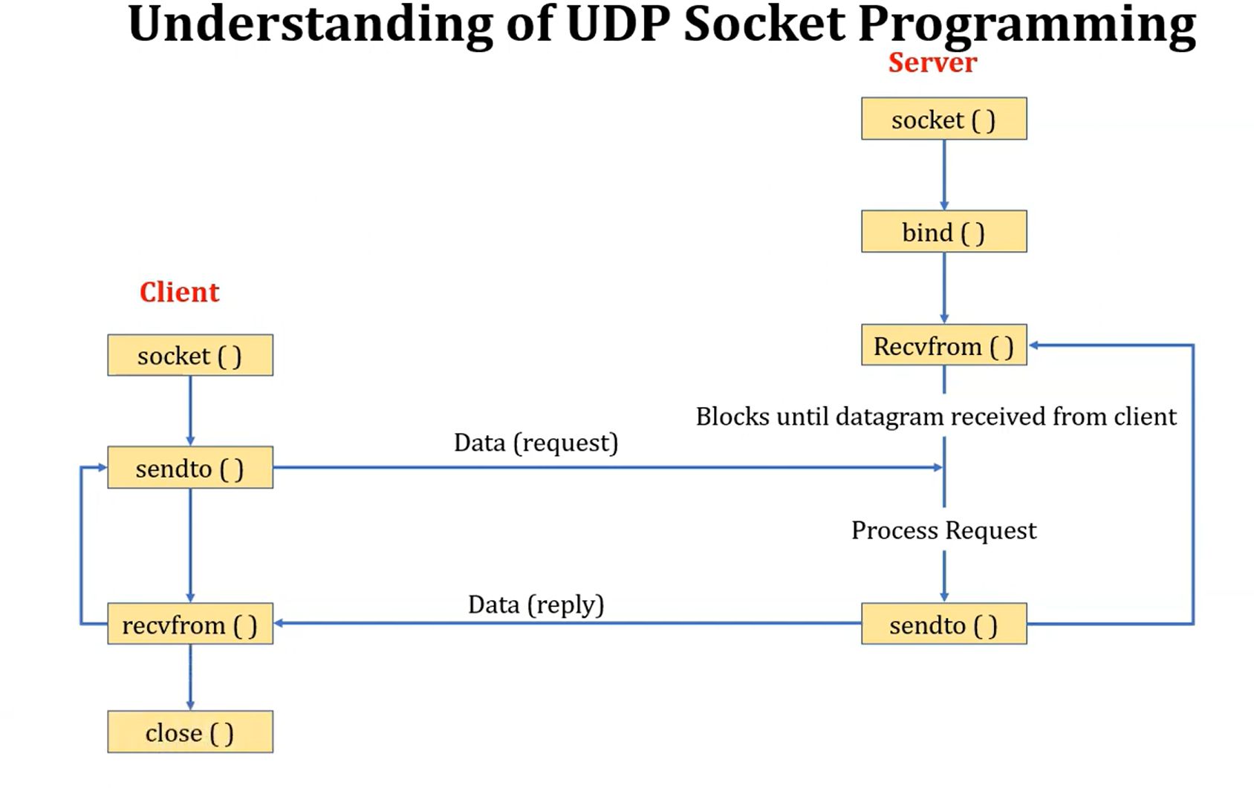

Slide 22
Advantages of the Client-Server Model
Centralized Data Management: Easy to maintain and back up data.
Cost Efficiency: Clients require less processing power.
Scalability: Servers and clients can scale independently.
Security: Centralized security policies and authentication.
Data Recovery: Easier backup and restore from a single source.
Disadvantages of Client-Server Model
Client Vulnerability: Risk of malware if servers distribute unsafe files.
Server as a Target: Susceptible to DDoS (Denial of Service) attacks.
Data Spoofing: Unprotected data can be tampered with in transit.
MITM Attacks: Unsecured connections can be intercepted by attackers.

Slide 23
Thank You

